Slide 1
UML Activity Diagram

Slide 2
Activity Diagram
Activity diagram is another important diagram in UML to describe the dynamic aspects of the system
Activity diagram is basically a flowchart to represent the flow from one activity to another activity.
The activity can be described as an operation of the system.

Slide 3
Activity Diagram Flow
The control flow is drawn from one operation to another.
This flow can be :
Sequential
Branched
Concurrent
Activity diagrams deal with all type of flow control by using different elements such as fork, join, et

Slide 4
Purpose of Activity Diagrams
The purpose of an activity diagram can be described as −
Draw the activity flow of a system.
Describe the sequence from one activity to another.
Describe the parallel, branched and concurrent flow of the system.

Slide 5
How to Draw an Activity Diagram?
Activity diagrams are mainly used as a flowchart
Activity diagrams are not exactly flowcharts as they have some additional capabilities.
These additional capabilities include branching, parallel flow, swimlane, etc

Slide 6
How to Draw an Activity Diagram?
Before drawing an activity diagram, we should identify the following elements −
Activities
Association
Conditions
Constraints

Slide 7
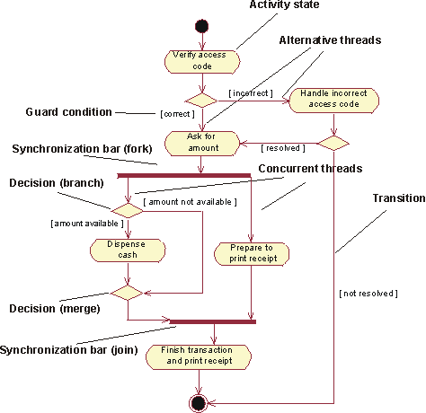

Slide 8
Following diagram is drawn with the four main activities −
Send order by the customer
Receipt of the order
Confirm the order
Dispatch the order

Slide 9
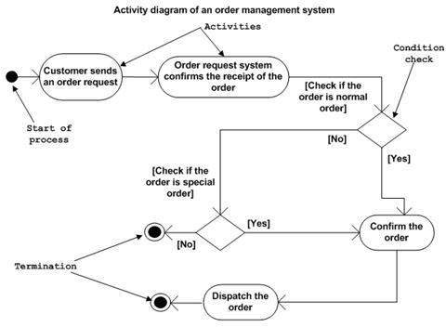

Slide 10
Where to Use Activity Diagrams?
Activity diagram can be used for −
Modeling work flow by using activities.
Modeling business requirements.
High level understanding of the system's functionalities.
Investigating business requirements at a later stage

Slide 11
Reference
Chapter 8: Building the Analysis Model
Software Engineering; A Practitioner’s Approach, 6th edition, Roger Pressman, McGraw-Hill

